Slide 1
Arun Mallya Advisor: Svetlana Lazebnik 13 March 2015

Slide 2
What I have been working on
Problem: Given a single image of an indoor room, recover its spatial layout
Notes:
Question answering, speech recognition
Note that order of the words matters

Slide 3
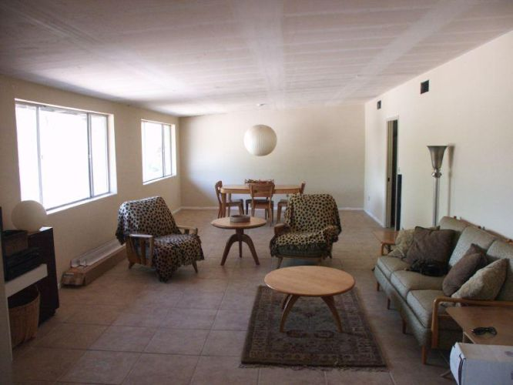
Notes:
Question answering, speech recognition
Note that order of the words matters

Slide 4
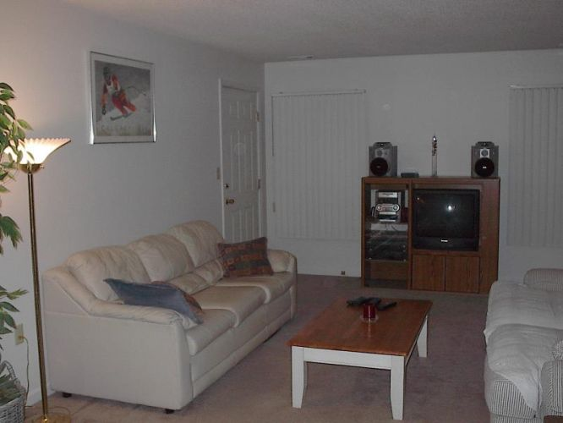
Notes:
Question answering, speech recognition
Note that order of the words matters

Slide 5
What I have been working on
Problem: Given a single image of an indoor room, recovering its spatial layout
Approach: Fit a parametric 3D box to the room
Notes:
Question answering, speech recognition
Note that order of the words matters

Slide 6
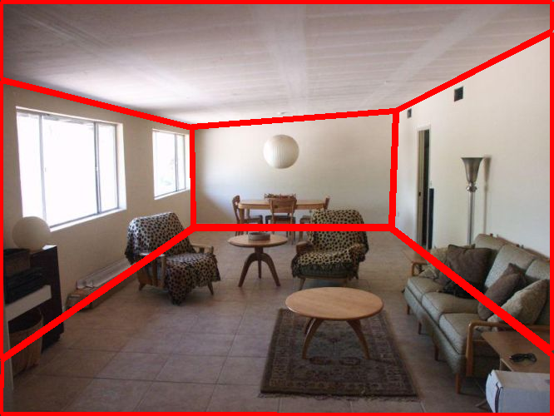
Notes:
Question answering, speech recognition
Note that order of the words matters

Slide 7
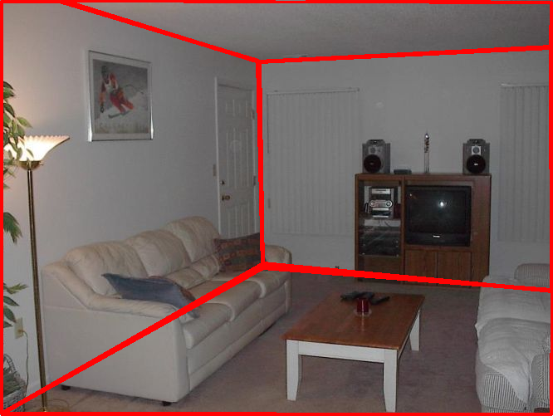
Notes:
Question answering, speech recognition
Note that order of the words matters

Slide 8
Layout Parametrization
r₃
r₄
r₁
vp₀
vp₂
r₂
Layout: (vp₀, vp₁, r₁, r₂, r₃, r₄)
vp₁

Slide 9
A brief background
Introduced by Hedau, Hoiem & Forsyth
Features based on Long Lines and Geometric Context
Structured SVM for best layout selection
Inference:
Latent SVMs
Volumetric Reasoning
Fast and Exact Inference using Branch & Bound
Features:
Orientation Maps
Notes:
Question answering, speech recognition
Note that order of the words matters

Slide 10
What I have been working on
Problem: Given a single image of an indoor room, recovering its spatial layout
Approach: Fit a parametric 3D box to the room
My contributions:
A new fast edge-based feature (< 1s computation vs. ∼10s)
Helpful in generating inference proposals
Improved inference
Notes:
Question answering, speech recognition
Note that order of the words matters

Slide 11
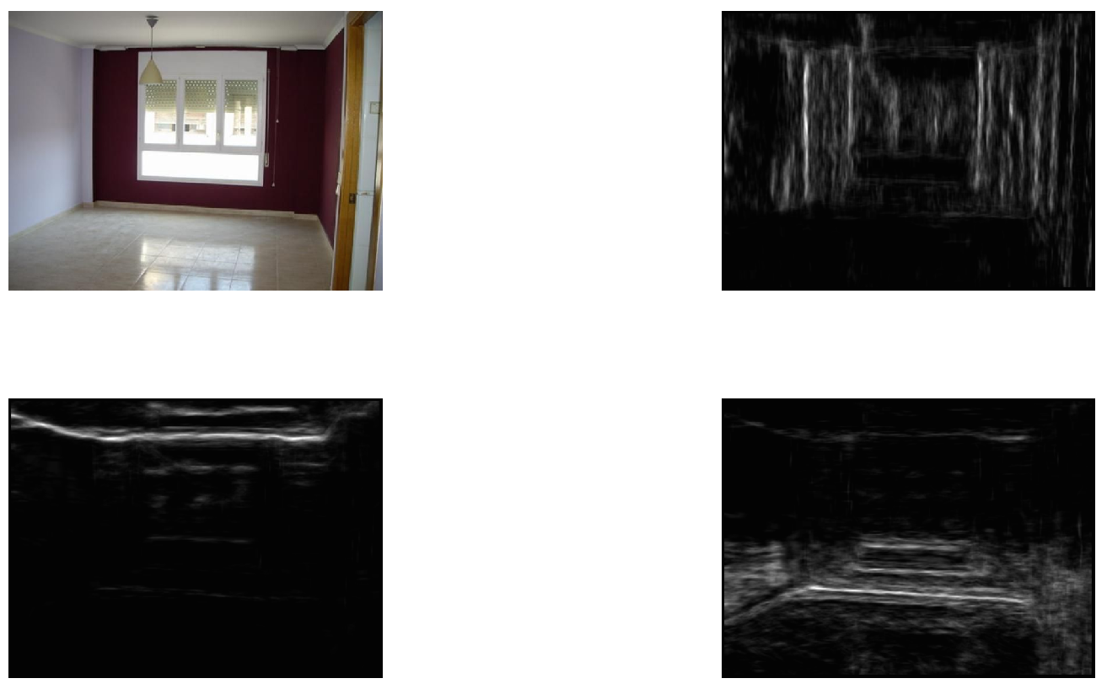
Input Image

Slide 12
Input Image
Input Image
Detected Wall Edges
Detected Ceiling Edges
Detected Floor Edges

Slide 13
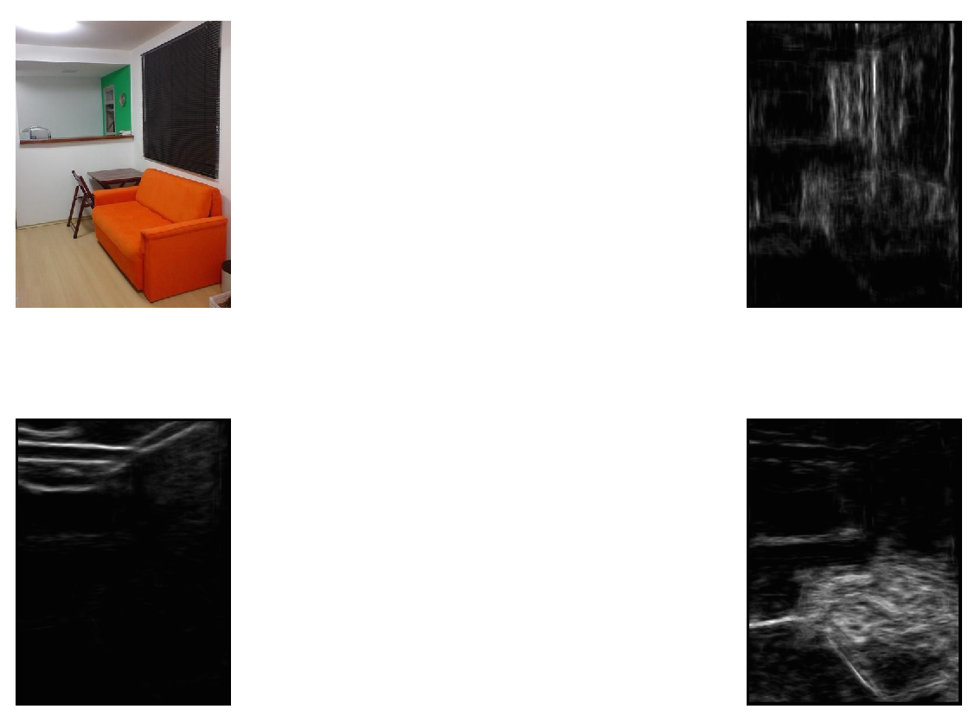
Input Image

Slide 14
Input Image
Detected Wall Edges
Detected Ceiling Edges
Detected Floor Edges

Slide 15
Edge Features
Edges are learned using the Structured Forests for Edge Detection by Dollár
Trained on 500 indoor scenes from SUN dataset
Applied to Hedau’s indoor scene dataset
Features extracted from proposed layouts:
Percentage of edge strengths in face
Percentage of edge strengths along boundaries
Inference:
Propose rays in regions of high edge activity
6 chosen rays/VP vs. 10 uniformly spaced rays/VP
Notes:
Question answering, speech recognition
Note that order of the words matters

Slide 16
Preliminary Results
Method | Bounding Box Overlap Error
Initial Work – Hedau & Hoiem | 21.2%
Latent SVM – Koller et al. | 20.1%
Volumetric Reasoning – Kanade et al. | 16.2%
Line + Edge Features | 15.9%
Exact Inference – Schwing & Urtasun | 13.6%
Highlighted works use Geometric Context and/or Orientation Maps
Notes:
Question answering, speech recognition
Note that order of the words matters

Slide 18
Sequence to Sequence Learning with Neural Networks
Ilya Sutskever, Oriol Vinyals, Quoc V. Le
NIPS 2014

Slide 19
Task
Mapping Sequences to Sequences
Map data
That has sequential or temporal structure
Of arbitrary length
“What day is it today?” – “Today is a Friday”
Language Translation
“Good morning sir” – “Bonjour monsieur”
Notes:
Question answering, speech recognition
Note that order of the words matters

Slide 20
Feed-Forward Neural Networks
Outputs
y₁
y_{i}
y_{j}
Hidden Units
h₁
h₂
h_{k}
Inputs
x₁
x₂
x_{n}

Slide 21
Feed-Forward Neural Networks
Work well when large datasets are available
Generally require static inputs and targets of known and fixed dimensionality
Can not learn concepts on sequential data of arbitrary length, are time-window based
Notes:
Speech recognition, Machine Translation

Slide 22
Recurrent Neural Networks
Outputs
y₁
y_{i}
y_{j}
Hidden Units
h₁
h₂
h_{k}
Inputs
x₁
x₂
x_{n}

Slide 23
Recurrent Neural Networks
Outputs
y₁
y_{i}
y_{j}
Hidden Units
h₁
h₂
h_{k}
Inputs
x₁
x₂
x_{n}

Slide 24
y₁
y₂
y_{n}
j
w₁₁
w_{nm}
w_{ji}
x₁
x₂
x_{m}
i

Slide 25
Recurrent Neural Networks
t = 3
t = 2
t = 1

Slide 26
Error Layer (E)
Layer L
Layer L-1
Layer L-2
Input

Slide 27
Error
x
t

Slide 28
y
f(x;w)
x

Slide 29
y
Sigmoid
x

Slide 30
Recurrent Neural Networks
Can learn concepts on arbitrary input sequences
Time dependence creates “network memory”
Limited successes
Very slow convergence
Decay of back-propagated error
Issue with long time lags between relevant events

Slide 31
Long Short Term Memory (LSTM)
Replacement for the simple neuron cell
Introduces memory in each cell
Enforces non-decaying error flow
Learns across long time lags
Faster convergence

Slide 32
LSTM – Overview
x_{t} h_{t-1}
x_{t} h_{t-1}
Input Gate
i_{t}
Output Gate
o_{t}
Cell
x_{t}
h_{t-1}
c_{t}
h_{t}
f_{t}
Forget Gate
x_{t} h_{t-1}

Slide 33
LSTM – Cell
Cell (t-1)
c

Slide 34
LSTM – Cell
Cell (t-1)
x_{t}
h_{t-1}
c
_{C’t}

Slide 35
LSTM – Input Gate
x_{t} h_{t-1}
Input Gate
i_{t}
Cell (t-1)
x_{t}
h_{t-1}
c
c’_{t}

Slide 36
LSTM – Input Gate
x_{t} h_{t-1}
Input Gate
i_{t}
Cell (t-1)
x_{t}
h_{t-1}
c
x’_{t}
x’’_{t}

Slide 37
LSTM – Forget Gate
x_{t} h_{t-1}
Input Gate
i_{t}
Cell (t-1)
x_{t}
h_{t-1}
c
x’_{t}
x’’_{t}
f_{t}
Forget Gate
x_{t} h_{t-1}

Slide 38
LSTM – Forget Gate
x_{t} h_{t-1}
Input Gate
i_{t}
Cell (t-1)
x_{t}
h_{t-1}
c
c’_{t}
f_{t}
Forget Gate
x_{t} h_{t-1}

Slide 39
LSTM – Cell Update
x_{t} h_{t-1}
Input Gate
i_{t}
Cell (t-1)
x_{t}
h_{t-1}
c
c’_{t}
f_{t}
Forget Gate
x_{t} h_{t-1}

Slide 40
LSTM – Updated Cell
x_{t} h_{t-1}
Input Gate
i_{t}
Cell (t)
x_{t}
h_{t-1}
c_{t}
f_{t}
Forget Gate
x_{t} h_{t-1}

Slide 41
LSTM – Output
x_{t} h_{t-1}
x_{t} h_{t-1}
Input Gate
i_{t}
Cell
x_{t}
h_{t-1}
c_{t}
o_{t}
f_{t}
Forget Gate
x_{t} h_{t-1}

Slide 42
LSTM – Output Gate
x_{t} h_{t-1}
x_{t} h_{t-1}
Input Gate
i_{t}
Output Gate
o_{t}
Cell
x_{t}
h_{t-1}
c_{t}
f_{t}
Forget Gate
x_{t} h_{t-1}

Slide 43
LSTM – Final Output
x_{t} h_{t-1}
x_{t} h_{t-1}
Input Gate
i_{t}
Output Gate
o_{t}
Cell
x_{t}
h_{t-1}
c_{t}
h_{t}
f_{t}
Forget Gate
x_{t} h_{t-1}

Slide 44
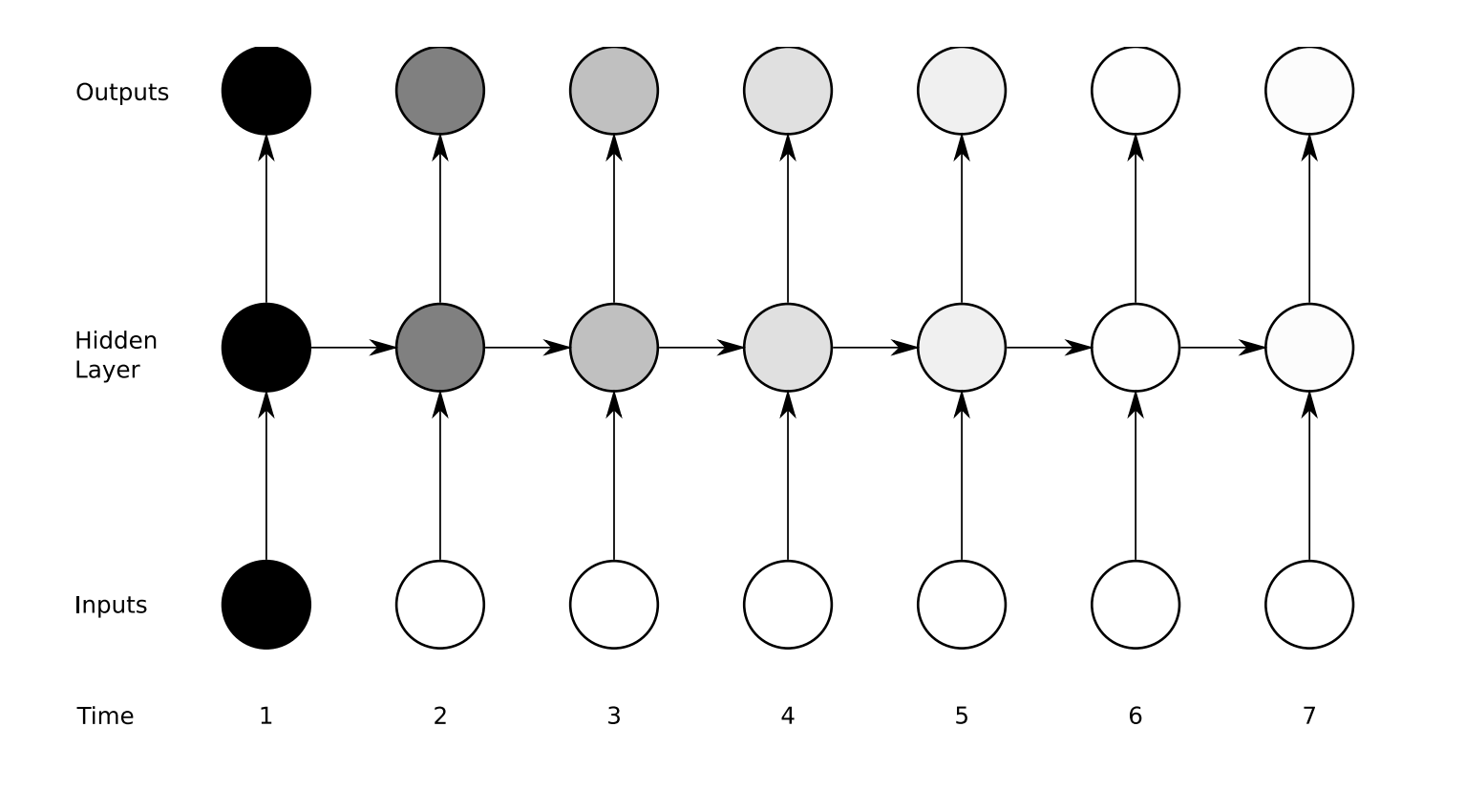
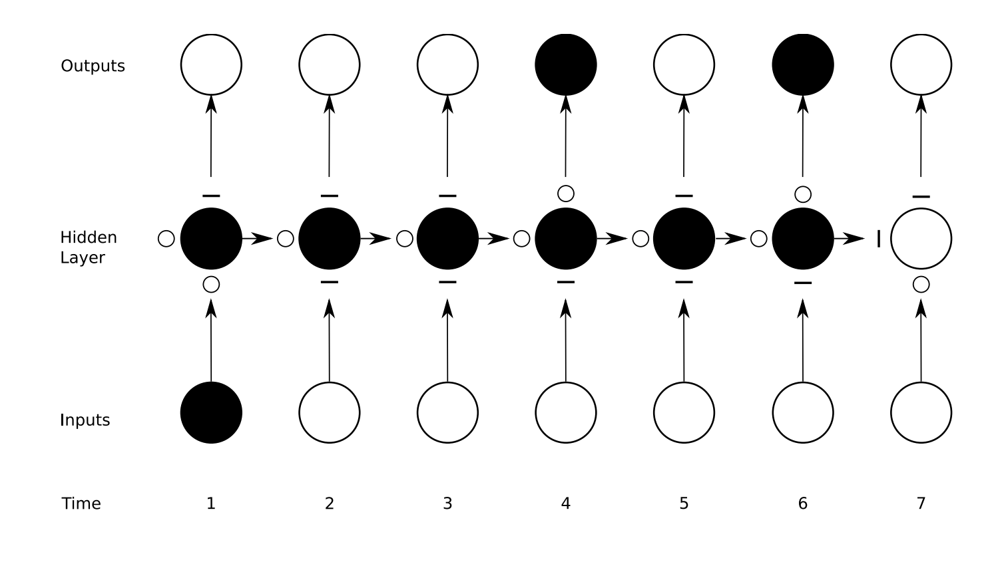
RNN
LSTM

Slide 45
Idea
We have LSTMs which can learn on sequential data with long range temporal dependencies
Represent sentences as vectors
Read input sentence word by word (timestep by timestep)
Generate output sentence word by word

Slide 46
A Minor Hiccup
Recall general RNN equation
Each x_{t} has a corresponding y_{t}: Alignment between sequences should be known ahead of time
Workaround:
Map entire input to a fixed-size vector
Map fixed-sized vector to output

Slide 47
Model

Slide 48
Model

Slide 49
Example

Slide 50
Network Structure
good
morning
sir
EOS
LSTM₁
LSTM₂
LSTM₃
LSTM₄
v
LSTM₇
LSTM₆
LSTM₅
EOS
monsieur
bonjour
subscript indicates time step

Slide 51
Optimization Tricks
Reverse words of the input sentence
Map (c, b, a) to (X, Y, Z) instead of Map (a, b, c) to (X, Y, Z)
Introduces many short-term dependencies
Easier to learn, Faster to learn
Use Deep LSTMs instead of single layer
4 layers with 1000 cells each
More learning power
Use two different LSTMs: one for input (encoder), one for output (decoder)
Allows to train on multiple language pairs simultaneously

Slide 52
Final Network Structure
sir
morning
good
EOS
Encoder
LSTM₁
Encoder
LSTM₂
Encoder
LSTM₃
Encoder
LSTM₄
v
Decoder
LSTM₃
Decoder
LSTM₂
Decoder
LSTM₁
EOS
monsieur
bonjour
subscript indicates time step

Slide 53
Final Network Structure
order
reversed
sir
morning
good
EOS
Encoder
LSTM₁
Encoder
LSTM₂
Encoder
LSTM₃
Encoder
LSTM₄
deeper
network
different input-output networks
v
Decoder
LSTM₃
Decoder
LSTM₂
Decoder
LSTM₁
EOS
monsieur
bonjour
subscript indicates time step

Slide 54
Training and Decoding
Maximize log probability of correct translation T, given source X
Decode using beam search

Slide 55
Evaluation Task
Direct English to French translation
Rescore 1000-best lists obtained from baseline method – Moses SMT
Score based on log-probability of translation
Average with score from 1000-best list

Slide 56
Evaluation Metric
BLEU Score: Measures correspondence between machine output and human translation
Weighted sum of log of n-gram precisions
Penalty for brevity

Slide 57
Moses

Slide 58
Word Embeddings

Slide 59
Backpropagation

Slide 60
More Details
WMT’14 English to French dataset
12M sentences with 348M French & 304M English words
Vectorized using 160k, 80k most frequent words in source and target languages resp.
SGD without momentum, with step learning rate and gradient truncation were used
Minibatches were chosen such that all sentences in a minibatch are roughly of the same length

Slide 61
Related Work
Baseline: Moses SMT
Phrase based system
Includes factored phrase representations
State-of-the-art: Edinburg MT System
Phrase based system
Word clusters, unsupervised transliteration, etc.
NN Approaches: RNN Encoder-Decoder, Cho et al.
Similar architecture, different cell, fewer params
Embedding of 100 v/s 1000 in LSTM

Slide 62
Performance - Direct Translation
Method | BLEU on test
MOSES (baseline) | 33.30
Single forward LSTM, beam size 12 | 26.17
Single reversed LSTM, beam size 12 | 30.59

Slide 63
Performance - Direct Translation
Method | BLEU on test
MOSES (baseline) | 33.30
Single forward LSTM, beam size 12 | 26.17
Single reversed LSTM, beam size 12 | 30.59
Ensemble of 2 reversed LSTMs, beam size 12 | 33.27

Slide 64
Performance - Direct Translation
Method | BLEU on test
MOSES (baseline) | 33.30
Single forward LSTM, beam size 12 | 26.17
Single reversed LSTM, beam size 12 | 30.59
Ensemble of 2 reversed LSTMs, beam size 12 | 33.27
Ensemble of 5 reversed LSTMs, beam size 1 | 33.00
Ensemble of 5 reversed LSTMs, beam size 2 | 34.50
Ensemble of 5 reversed LSTMs, beam size 12 | 34.81

Slide 65
Performance - Rescoring
Method | BLEU on test
MOSES (baseline) | 33.30
Edinburgh (State of the art) | 37.00
Single forward LSTM | 35.61
Single reversed LSTM | 35.85
Ensemble of 5 reversed LSTMs | 36.50
Oracle Rescoring | ∼45

Slide 66
Performance - Analysis
Accuracy improves with length until threshold, then falls

Slide 67
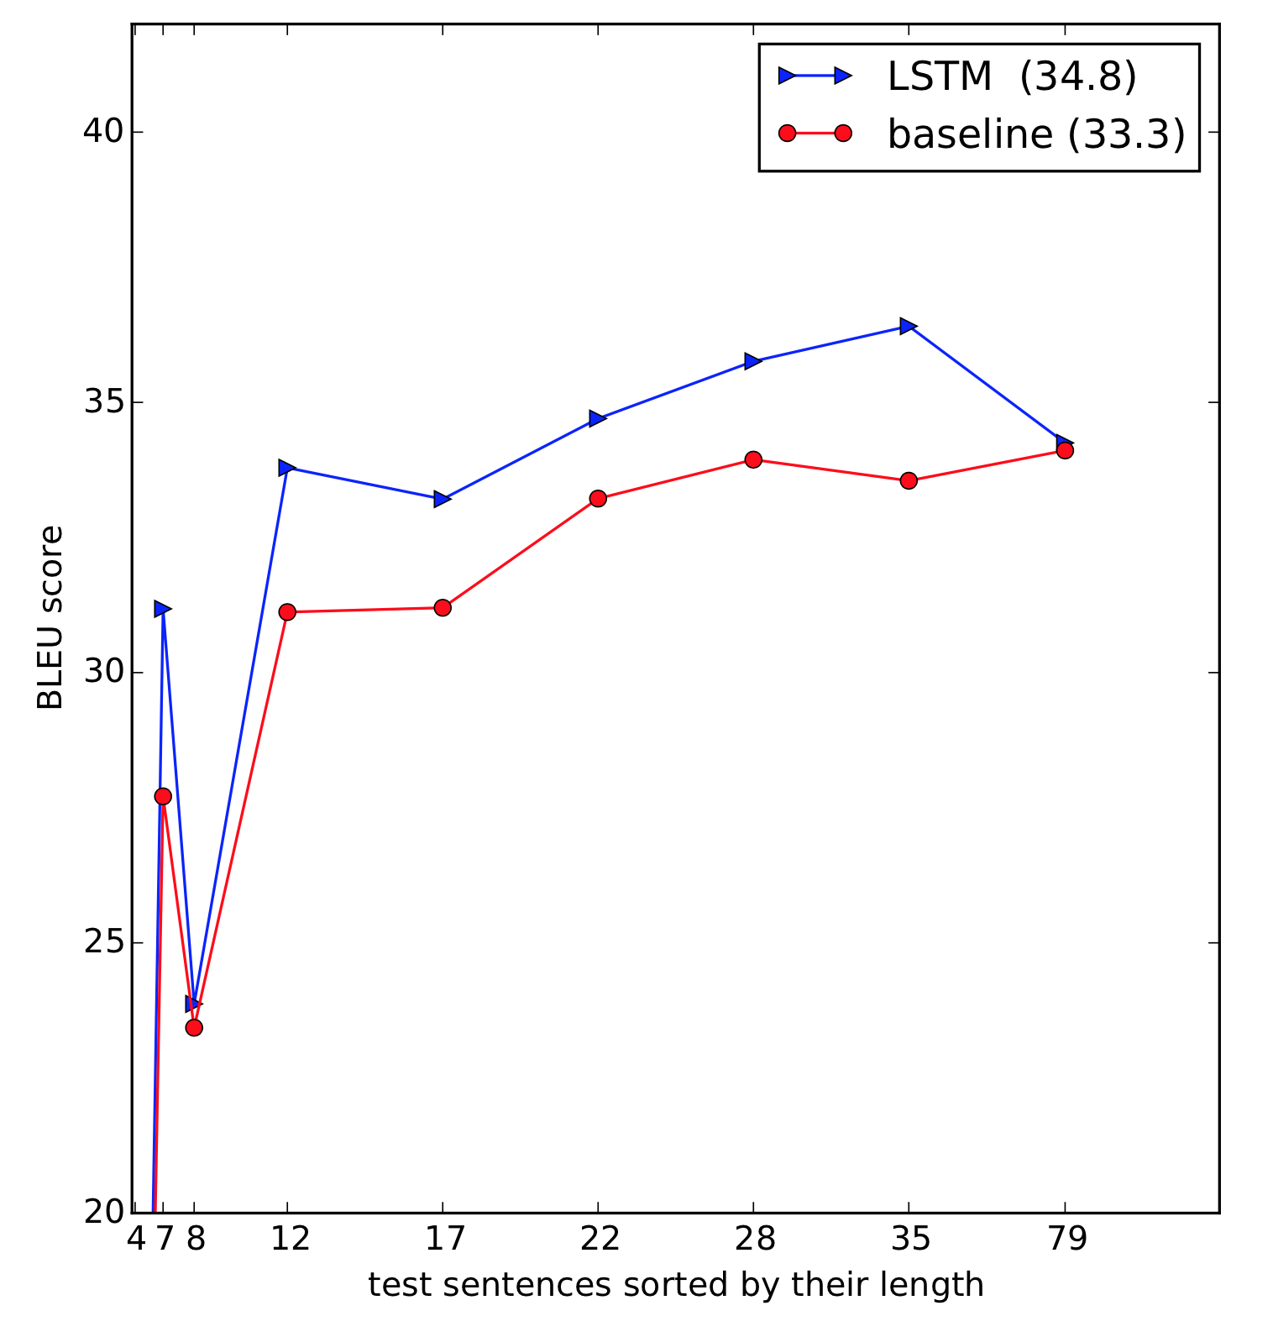
Performance - Analysis

Slide 68
Performance - Analysis
Accuracy improves with length until threshold, then falls
Accuracy is higher for sentences with commonly occurring words

Slide 69
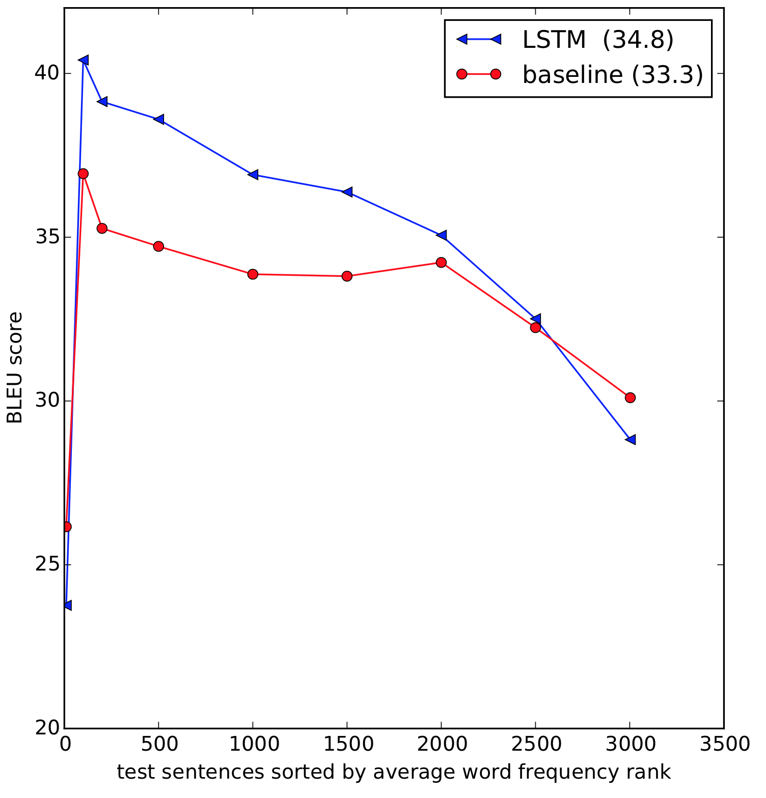
Performance - Analysis

Slide 70
Performance - Analysis
Accuracy improves with length until threshold, then falls
Accuracy is higher for sentences with commonly occurring words
Hidden representation are sensitive to order of words (actor-verb-receiver), insensitive to active-passiveness

Slide 71
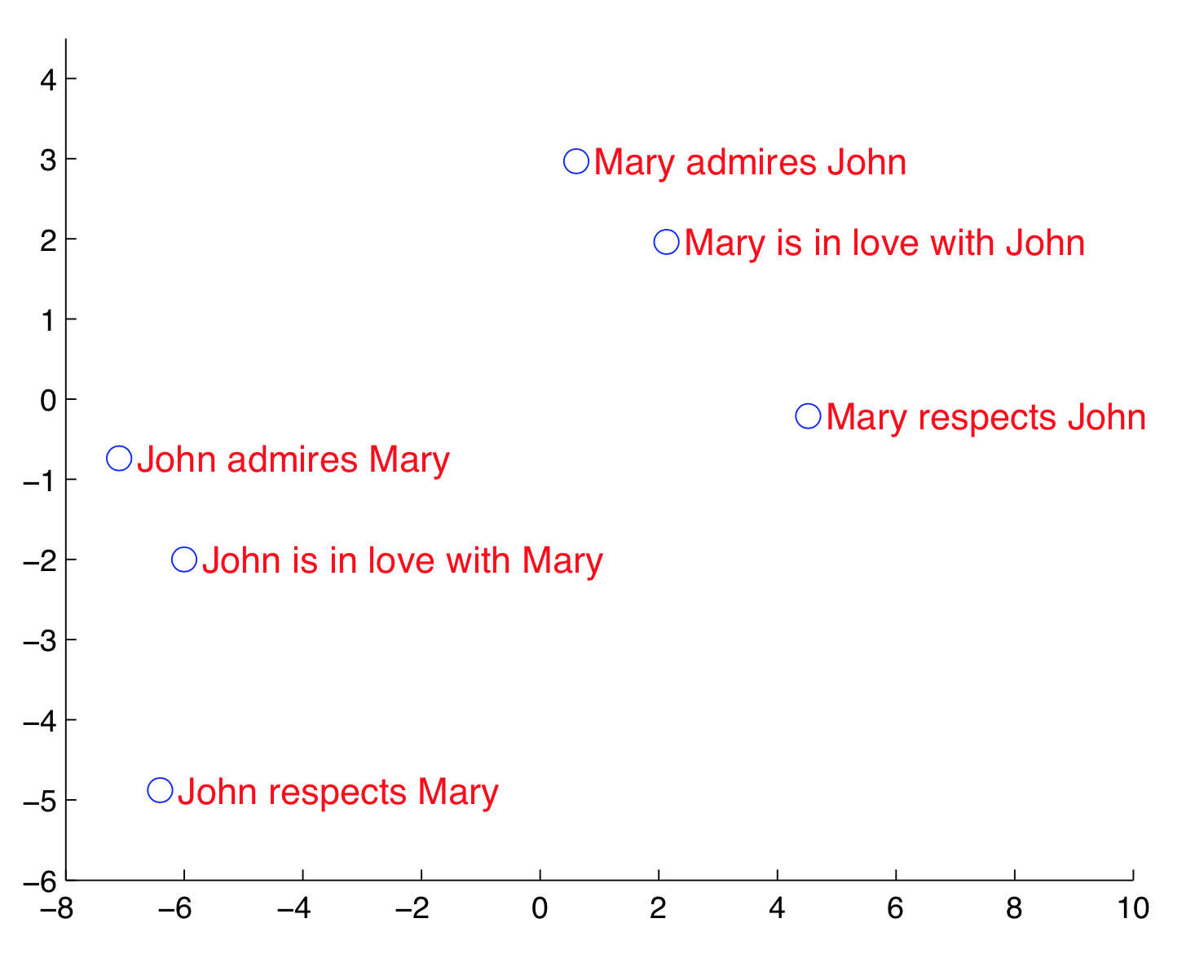
Performance - Analysis
2-dimensional PCA projection of the LSTM hidden states
obtained after processing the entire phrases

Slide 72
Takeaways
General purpose framework to solve sequential tasks with dependencies even over long time lags
Possible to summarize arbitrary-length sequence with fixed-length vector using LSTM
Reversing the inputs was crucial in this case:
Reduction in “minimal time lag”
Improved performance on long sequences
Eases trainability

Slide 73
Criticisms
The Cho et al. system used 15K most frequent words (vs 160K, 80K) for both source and target language, with just 1000 hidden units (vs 1000 x 4) and word embedding of 500 (vs 1000)
A lot more parameters for same performance
Results presented only on English-French
Most popular, but also easiest
Higher BLEU score possible due to larger word vector dimensionality

Slide 75
Bringing Semantics Into Focus Using Visual Abstraction
C. Lawrence Zitnick, Devi Parikh
CVPR 2013

Slide 76
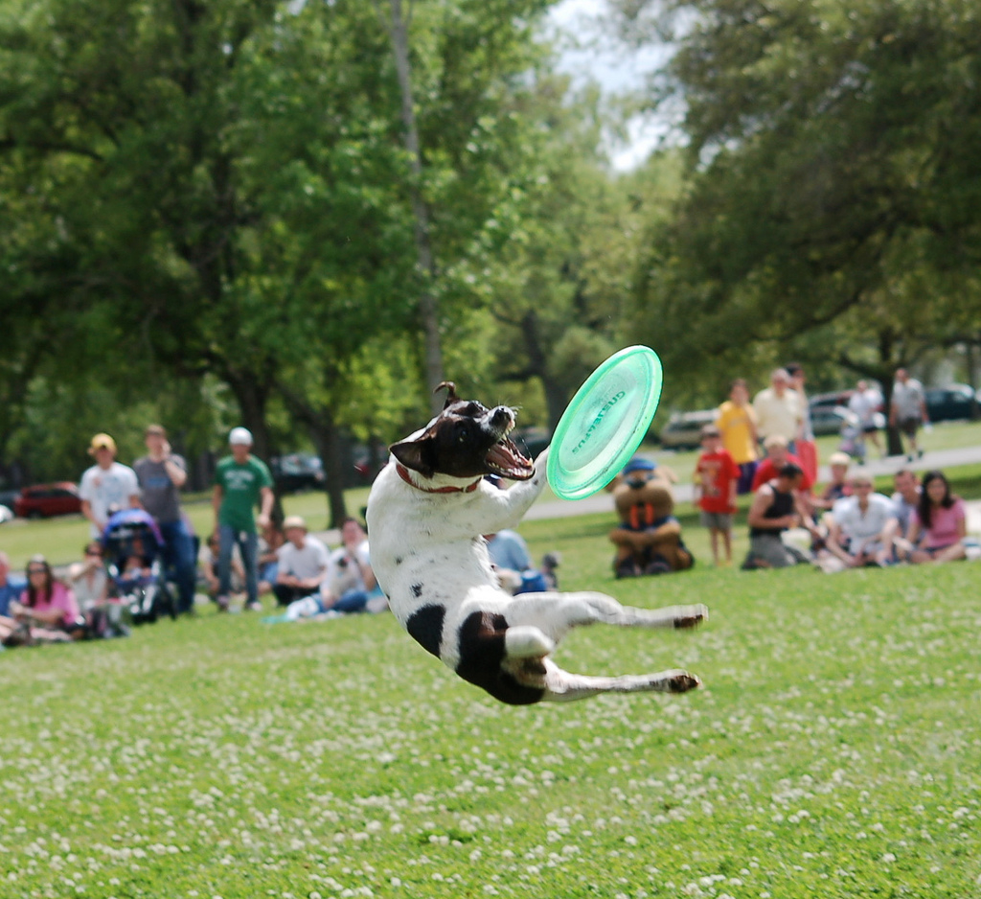
Dog catching a frisbee in a park while people sit in the back

Slide 77
Task
What is the relation between the linguistic semantic meaning and the visual information contained in an image?
‘Meaning’ of an image
Objects are present in the image
Their attributes (facial, pose, etc.)
Relations between objects
Analysis of semantic importance of visual features using synthetic images
Notes:
Question answering, speech recognition
Note that order of the words matters

Slide 78


Jenny loves to play soccer but she is worried that Mike will kick the ball too hard.
Mike and Jenny play outside in the sandbox. Mike is afraid of an owl that is in the tree.

Slide 79
Why Synthetic Images?
Overcomes difficulties of automation
State-of-the-art in object, pose, attribute detection is not up to the mark
Huge set of objects, attributes and relations
Possibility of generating different but semantically similar scenes
Generation in a controlled environment
Almost impossible to collect in the wild
Notes:
Question answering, speech recognition
Note that order of the words matters

Slide 80
Can Photorealism Be Traded Away?
Very important issue
Entire domain is shifted away from normal scenes
Different feature responses
Is knowledge transfer really possible?
Authors claim yes
Humans have the ability to endow simple abstract objects with emotional traits of humans
Cartoons are effective at conveying semantic information
Notes:
Question answering, speech recognition
Note that order of the words matters

Slide 81
Abstract Dataset Requirements
Images should be comprehensive
Wide variety of objects, actions, relations, etc.
Should generalize well to other domains
Scenes of children playing outside
Universal properties
Generalization helped by the fact that children act out ‘grown-up scenes’
Set of semantically similar scenes with descriptions
Notes:
Question answering, speech recognition
Note that order of the words matters

Slide 82








Clipart Collection
Person: boy and girl with 7 different poses & 5 different facial expressions (35)
Other Objects: airships, animals, trees, hats, toys, weather, balls, glasses, food, large objects (56)
Notes:
Question answering, speech recognition
Note that order of the words matters

Slide 83
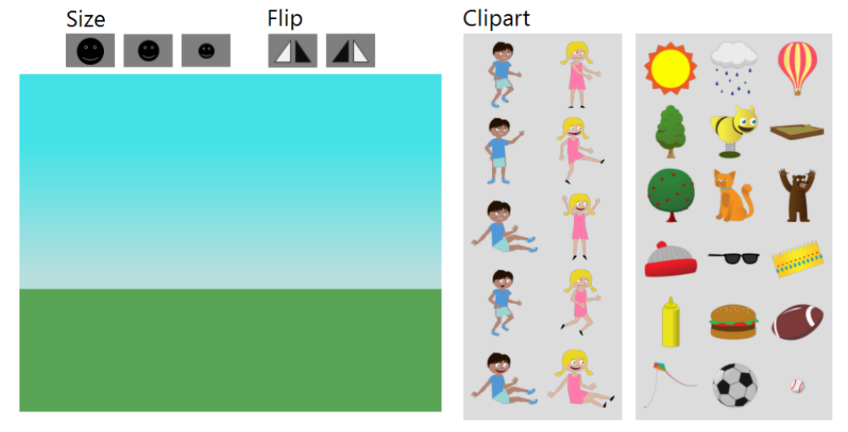
Seed Scene Generation
Background of grass and blue sky
Random subset of person clip art (5 boy + 5 girl)
Random subset of other objects clip art (18)
Ability to change size and flip clip art
At least 6 items in image, no double usage
Drag-n-drop to ‘create scene for children’s story book’
Notes:
Question answering, speech recognition
Note that order of the words matters

Slide 84


Scene Description Generation
Single scene shown, subjects asked to describe the scene in one or two sentences
Notes:
Question answering, speech recognition
Note that order of the words matters

Slide 85
Semantically Similar Scene Generation
Given written description, subjects are asked to generate novel scenes
Variation through multiple scenes for each description
Variability depends on description ambiguity
Same interface as seed scene generation
Clip art used in seed scene included
Necessary for consistency with descriptions
Might introduce some bias
Thus, clip art not used in seed scene excluded
Notes:
Question answering, speech recognition
Note that order of the words matters

Slide 86


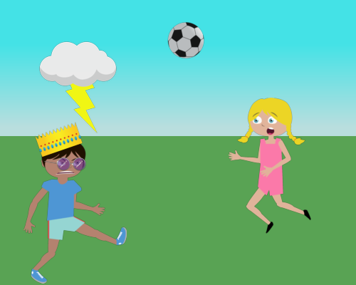


Final Dataset
Jenny loves to play soccer but she is worried that Mike will kick the ball too hard.
1002 descriptions with 10 scenes per description (10020 scenes in all)
Notes:
Question answering, speech recognition
Note that order of the words matters

Slide 87
Semantic Visual Features
Occurrence [binary]
Instance: boy (1), girl (1), all of other objects (56)
Category: person (1), other objects (10)
Person Attributes [binary]
facial (5), poses (7)
Co-occurrence [binary]
pairs of object instances occurring > 100 times (376)
Absolute Spatial Location [continuous 0-1]
GMM with 4 components for each object (58 x 4)
Relative Spatial Location [continuous 0-1]
GMM with 4 components for each pair of objects (58 x 57 x 4)
Depth Ordering [binary]
Absolute (58 x 3) and Relative (58 x 57 x 3) depth features
Notes:
Question answering, speech recognition
Note that order of the words matters

Slide 88
Metrics Used
Mutual Information
Conditional Mutual Information
to measure information gain from adding new features
Notes:
Question answering, speech recognition
Note that order of the words matters

Slide 89
Results – Occurrence
Objects such as bear, dog, girl, or boy are more semantically meaningful than background objects such as trees or hats
Categories are semantically more meaningful than instances in general
food, balls, animals score higher than hamburger, soccer ball, bear
No direct dependence between frequency of occurrence and semantic information
people, trees v/s bears, soccer balls
Notes:
Question answering, speech recognition
Note that order of the words matters

Slide 90
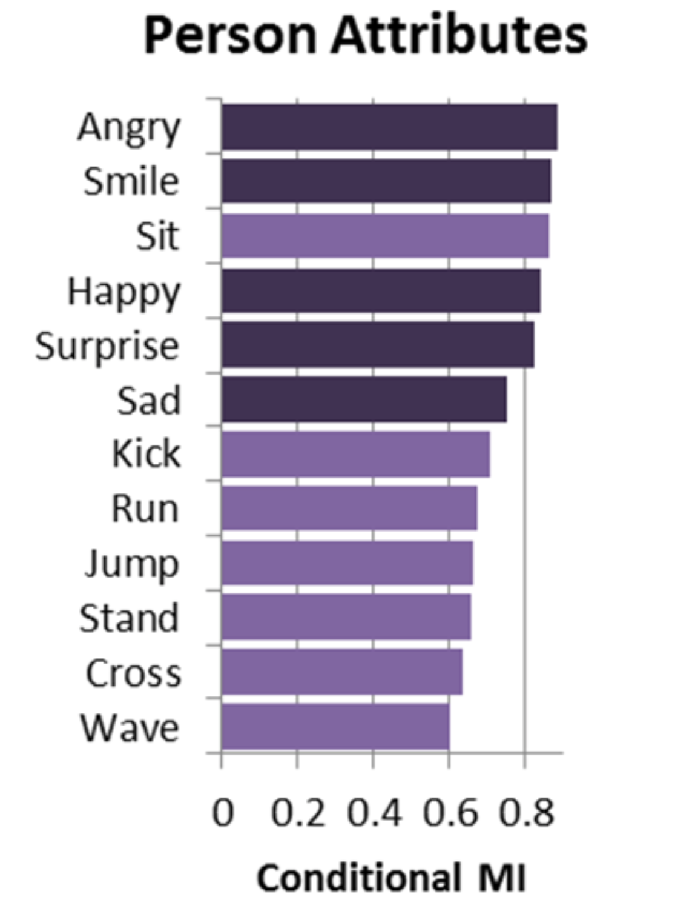
Results – Person Attributes
CMI of person attributes conditioned on presence of boy or girl
Expressions outscore actions
Notes:
Question answering, speech recognition
Note that order of the words matters

Slide 91
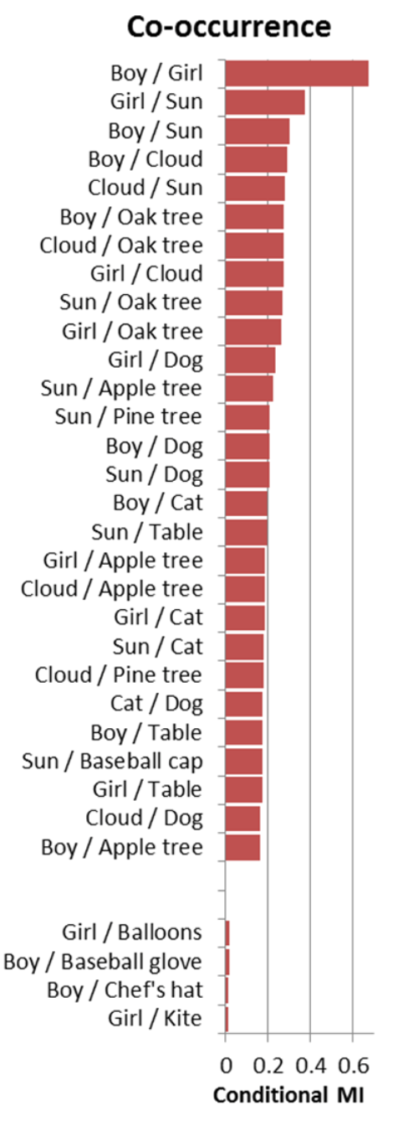
Results – Co-occurence
CMI computed over both of individual objects
Notes:
Question answering, speech recognition
Note that order of the words matters

Slide 92
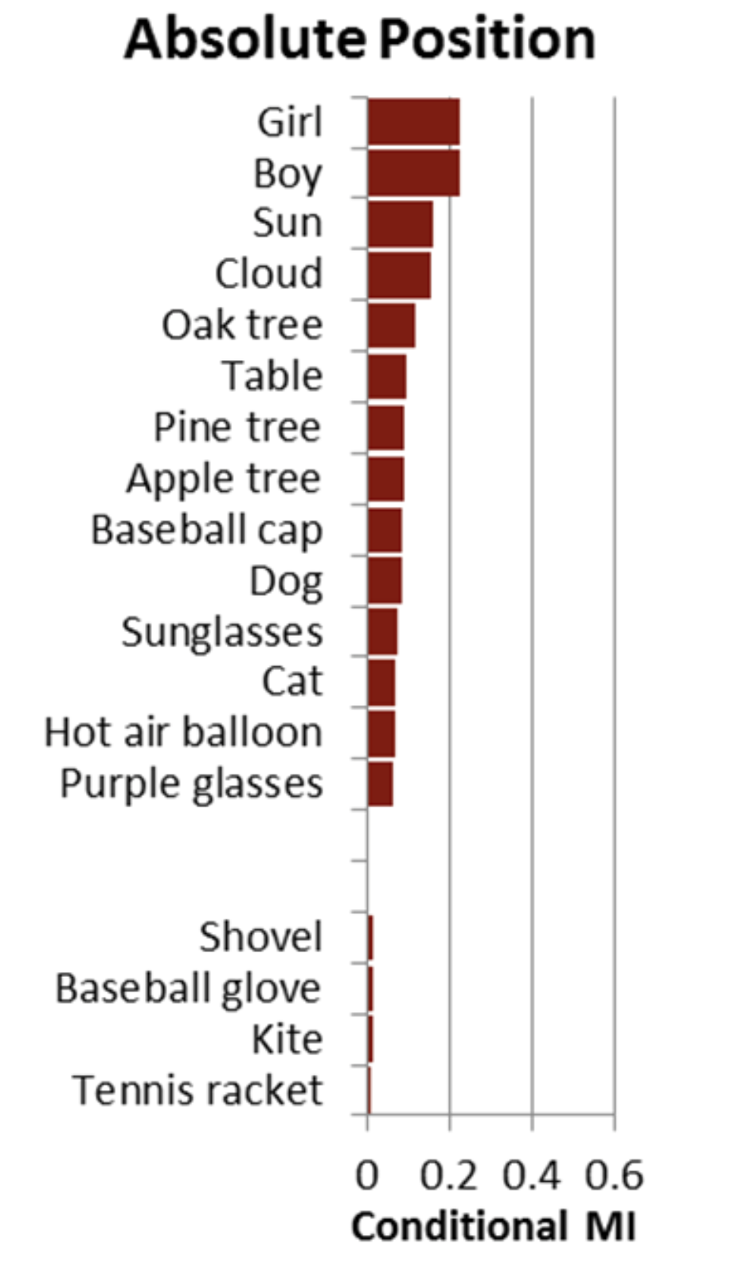
Results – Absolute Spatial Location
CMI of absolute spatial location conditioned over objects occurrence
Position of boy/girl adds most information, toys/hats adds little
Gains provided much less than all previous features
Notes:
Question answering, speech recognition
Note that order of the words matters

Slide 93
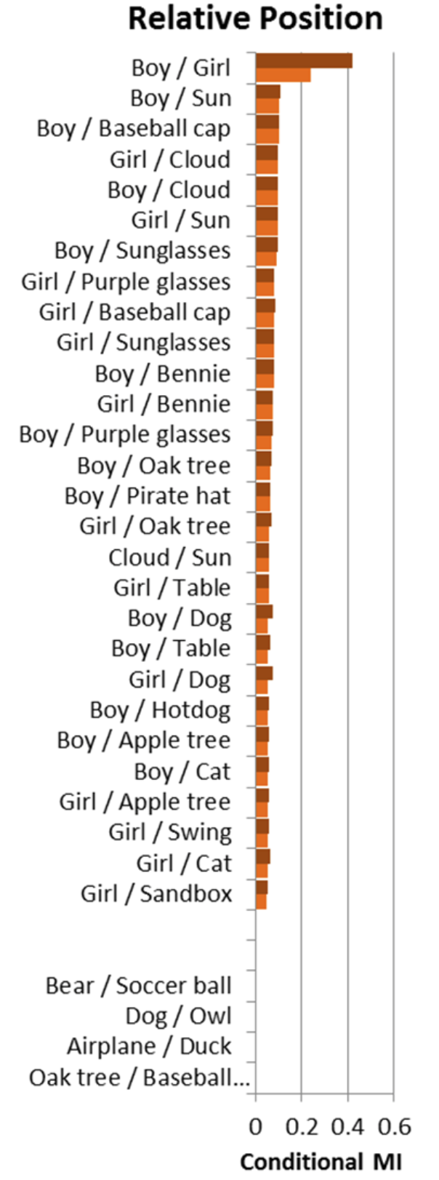
Results – Relative Spatial Location
CMI of relative spatial location conditioned over corresponding objects’ co-occurrence
Position of boy/girl adds most information
Knowledge of whether gaze is directed towards an object increases CMI
Notes:
Question answering, speech recognition
Note that order of the words matters

Slide 94
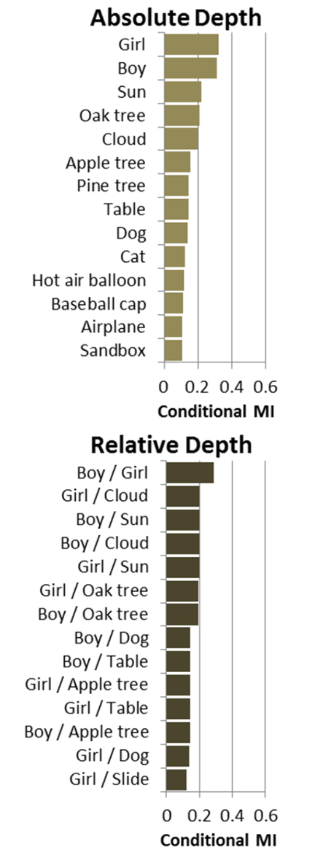
Results – Depth Ordering
CMI of absolute depth conditioned over object occurrence
CMI of relatives depth conditioned over objects’ co-occurrence
Notes:
Question answering, speech recognition
Note that order of the words matters

Slide 95
Semantic Visual Features v/s Low-level Image Features
Which type of features are best for measuring Semantic Similarity of images?
Semantic Visual Features
Top 200 based on MI/CMI scores
Low-level Image Features
GIST of 512 dimensions
Spatial Pyramid Models (SPM) + PCA of 512 dimensions
Recall measured using Large Margin NN
Notes:
Question answering, speech recognition
Note that order of the words matters

Slide 96
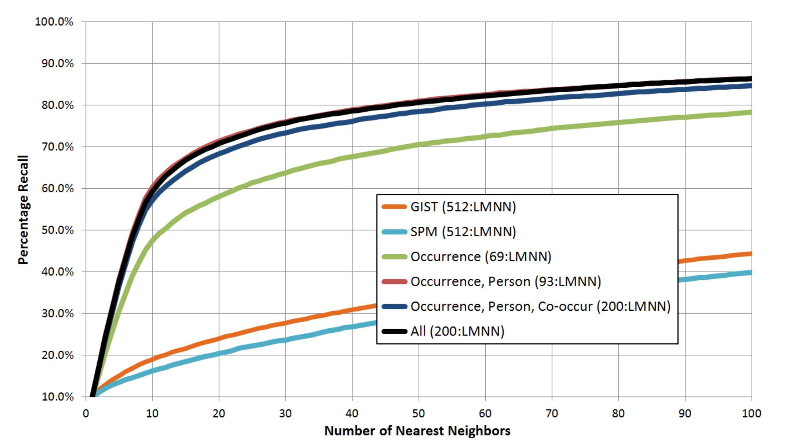
Semantic Visual Features v/s Low-level Image Features
Notes:
Question answering, speech recognition
Note that order of the words matters

Slide 97
Relation between text and visuals
Words with obvious visual meanings (Mike, Jenny, bear, slide, kicking) have high scores, while those with visual ambiguity (ruined, something, attention, using) have lower scores
Correspondence b/w semantic features and POS
Occurrence features – nouns
Relative position features – verbs, adverbs, prepositions
Notes:
Question answering, speech recognition
Note that order of the words matters

Slide 98
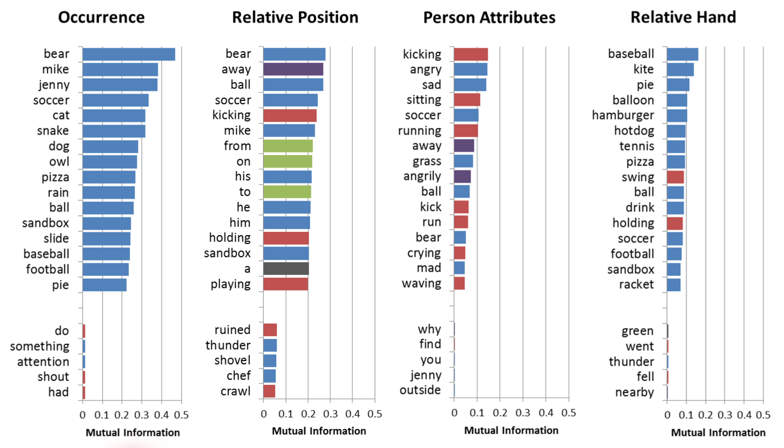
Semantic Features and POS
Blue – nouns, Red – Verbs, Green – Prepositions, Purple – Adverbs
Notes:
Question answering, speech recognition
Note that order of the words matters

Slide 99
Relation between text and visuals
Words with obvious visual meanings (Mike, Jenny, bear, slide, kicking) have high scores, while those with visual ambiguity (ruined, something, attention, using) have lower scores
Correspondence b/w semantic features and POS
Occurrence features – nouns
Relative position features – verbs, adverbs, prepositions
Most informative non-noun words depend on relative spatial position features
Notes:
Question answering, speech recognition
Note that order of the words matters

Slide 100
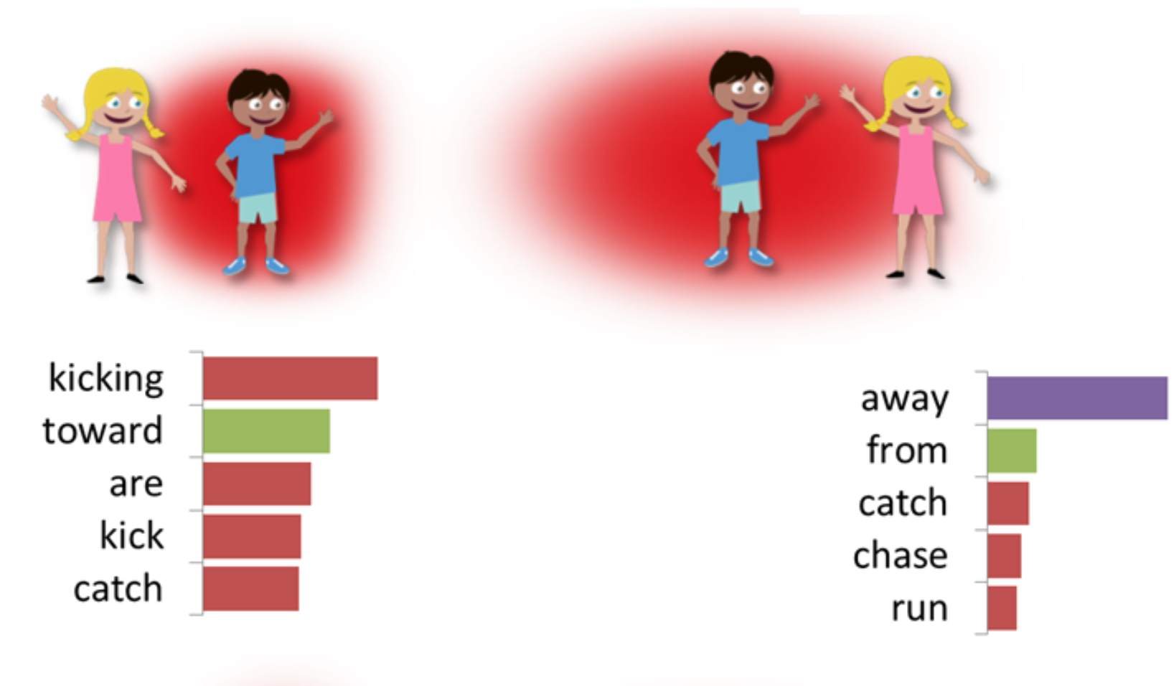
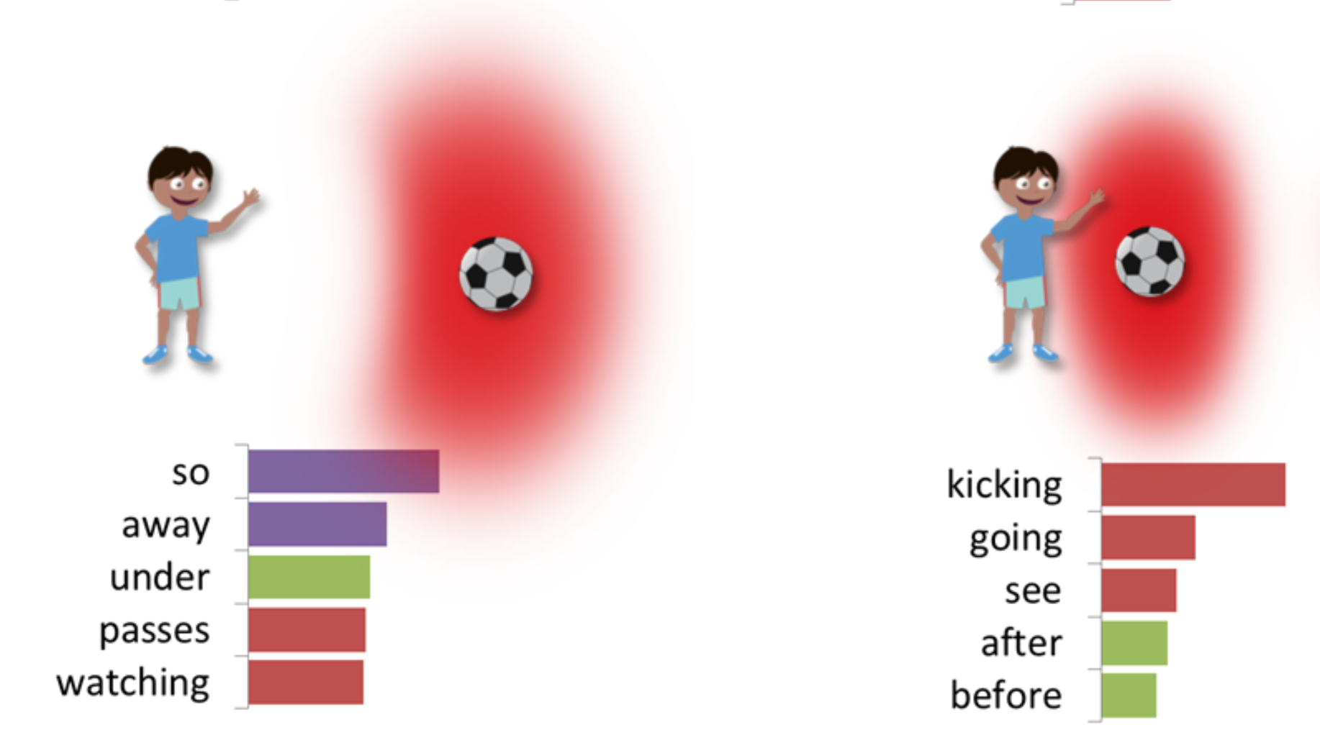
Impact of Relative Spatial Position
Blue – nouns, Red – Verbs, Green – Prepositions, Purple – Adverbs
Notes:
Question answering, speech recognition
Note that order of the words matters

Slide 101
Related Work
Caption Generation
Show and Tell: A Neural Image Caption Generator
Long-term Recurrent Convolutional Networks for Visual Recognition and Description
Deep Visual-Semantic Alignments for Generating Image Description
Analysis of different parts of speech
Measuring and predicting object importance, IJCV 2011
Relative Attributes, ICCV 2011
Recognition using visual phrases, CVPR 2011

Slide 102
Takeaways
High-level semantic features are useful and necessary, low-level features don’t really work well
High-level semantic features that help predict even complex phenomena represented by verbs, adverbs, and prepositions can be designed
New dataset that allows us to focus on designing high level semantic features without reliance on noisy low-level detection systems

Slide 103
Criticisms
Potentially oversimplified analysis
Very restricted dataset
Simple metrics
Rather obvious conclusions about usefulness of high-level semantic features
Generalizability: some conclusions might be specific only to this artificial dataset
No intuition provided for actually capturing high-level semantic features
How do we teach a system to actually learn them?

Slide 104
Thank You

